Slide 1
Basic Mathematics Concepts
1.2 Mathematics Review
from
Mark Allen Weiss’s Book

Slide 2




Exponents
$$x^{A}x^{B}=x^{A+B}$$
$$\frac{x^{A}}{x^{B}}= x^{A−B}$$
$$x^{N}{+ x}^{N}={2x}^{N} ≠ x^{2N}$$
$$2^{N}{+ 2}^{N}=2^{N+1}$$

Slide 3
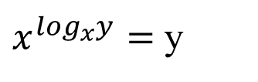
Logarithms and properties
In algorithm analysis we often use the notation “log n” without specifying the base
Binary logarithm
Natural logarithm
$x^{\log_{x}y}=$ y

Slide 4

Series & Summations
Arithmetic series:
Geometric series:
Special case: |x| < 1:
Harmonic series:

Slide 5
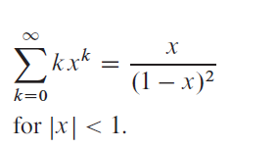
Common Summations
Other important formulas:

